Slide 1
Expert Network Flexible Foam
Team meeting 13th of May 2025

Slide 2
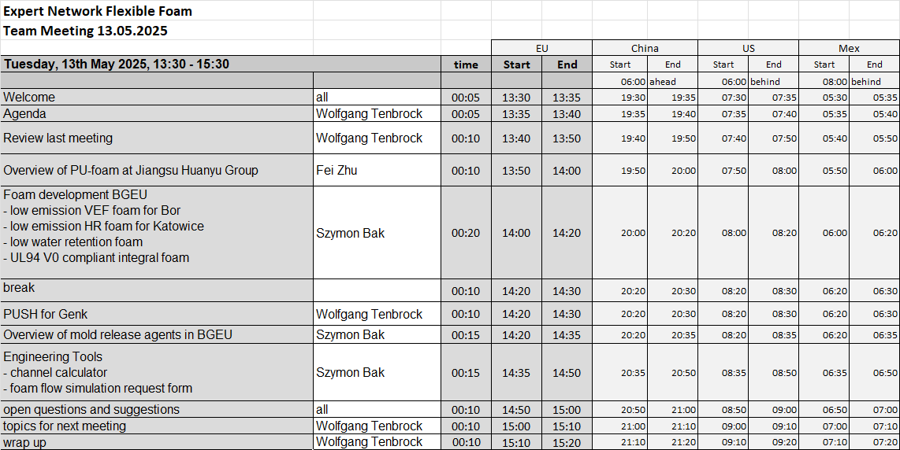

Slide 3
Foam development BGEU
BMW
NVH
BMW
carpets
JLR
e-motor
Volvo Trucks
NVH
Low emission HR foam for Katowice
Acoustiflex 27802
Low emission VEF foam for Bor
Acoustiflex 28952
Low water retention foam for Moissac
Acoustiflex 27802
UL94 V0 compliant foam for Moissac
EP 4895
low aldehyde emission
special applications
Implementation target: 2025 for all new foams
First mass trials completed in Q2
First mass trials completed in Q2
First mass trials on hold; possible change of requirements
First mass trials after final equipment will be installed
Next step Current status
Functional tests:
- emissions
- acoustics
Functional tests:
- emissions
- acoustics
Processability trials with high-pressure equipment
cw21 at CANNON
Discussions with JLR

Slide 5

Mould release agents in BGEU
PUR foam database
MOVE projects:
Katowice, Poland
Nowogard, Poland
Possibly superior:
tab:

Slide 6
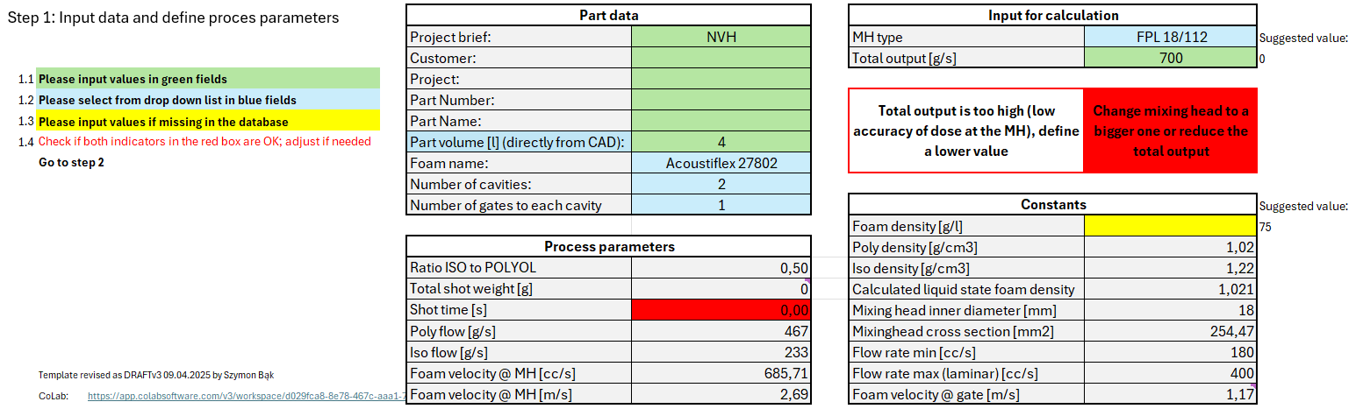
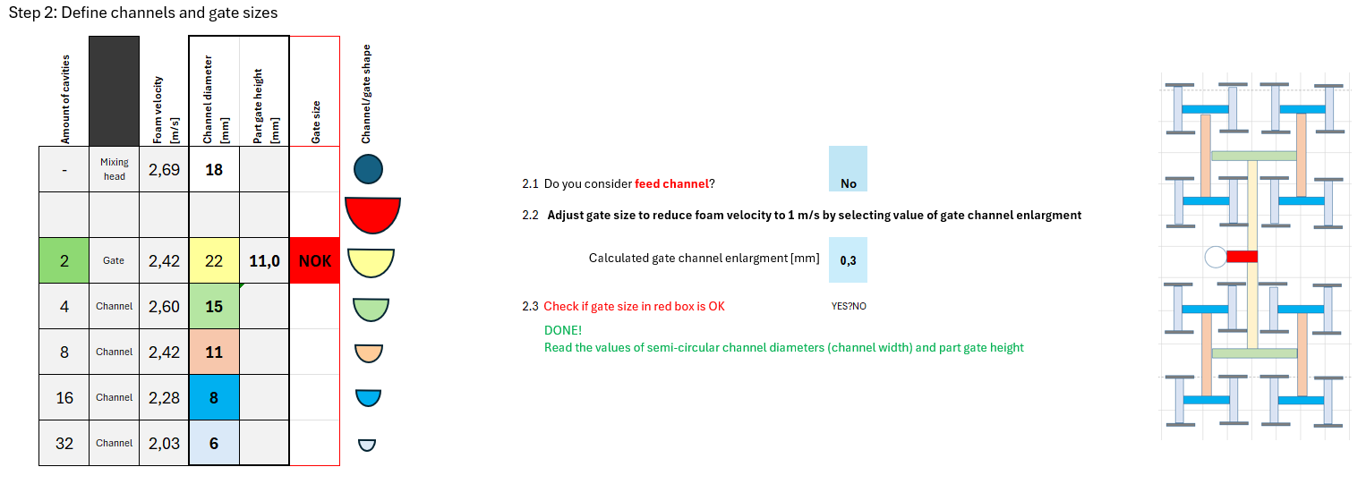
Engineering tools
Injection channel calculator
Injection channel calculator
Step 1 – project data and process parameters
Step 2 – calculation outputs and visualisation

Slide 7
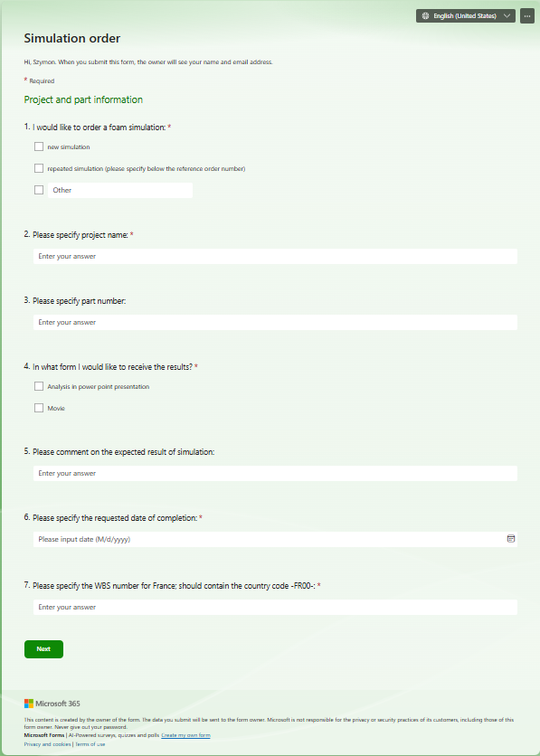
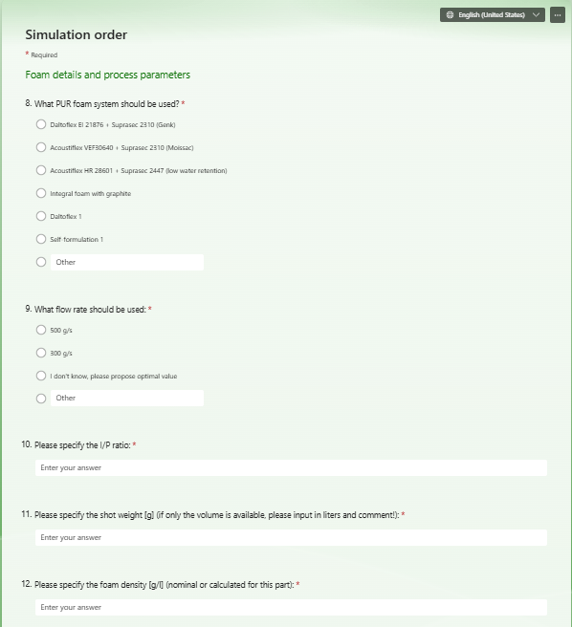
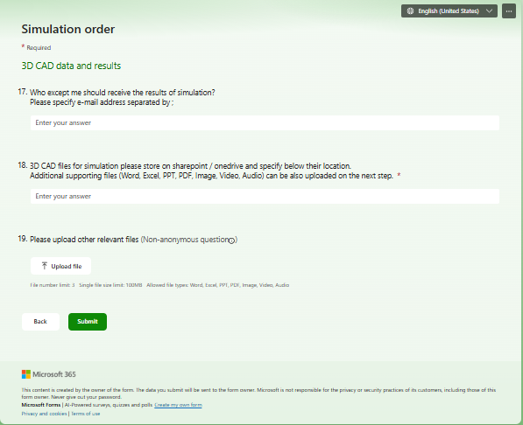
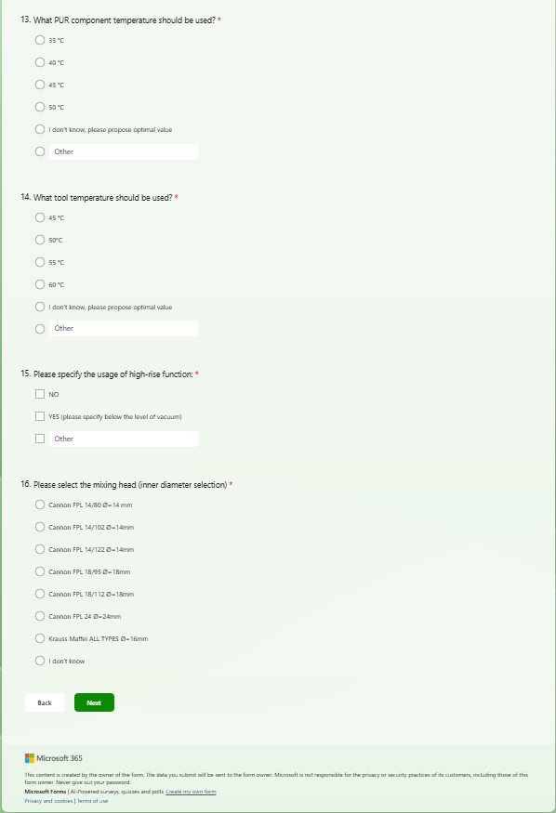
Engineering tools
Foam flow simulation request form
Simulation order
Step 1 – project data
Step 2 – process parameters
Step 3 – inputs/outputs

